Slide 1

A Machine Learning Approach to Identifying the Higgs Boson
Guy Amdur, Anton Apostolatos, Leonard Bronner

Slide 2
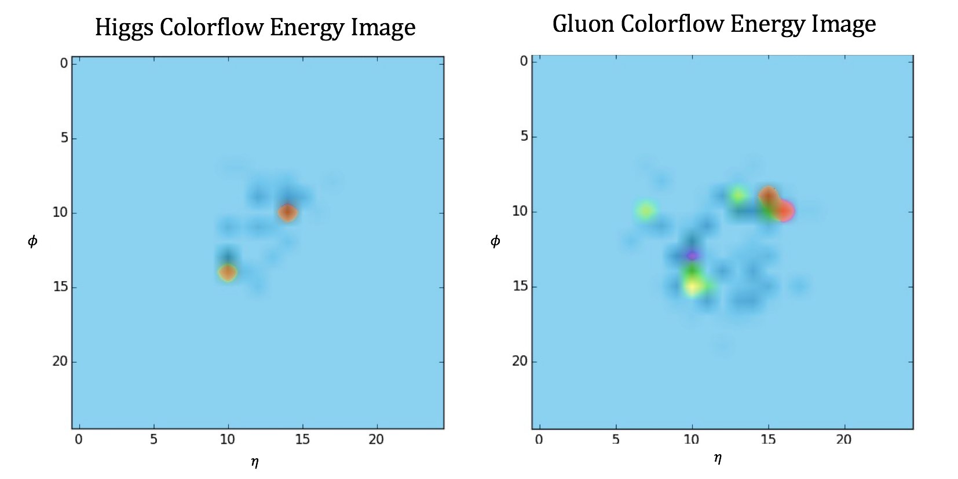
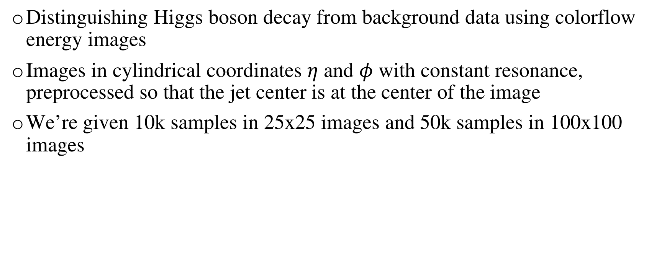
The Problem and the Data
Distinguishing Higgs boson decay from background data using colorflow energy images
Images in cylindrical coordinates $η$ and $φ$ with constant resonance, preprocessed so that the jet center is at the center of the image
We’re given 10k samples in 25x25 images and 50k samples in 100x100 images

Slide 3
Our methods
We split the data into a development set and a test set
Learn on the development and test on the unseen test set
Measure and compare ROC curves (plotting TPR and FPR at various thresholds) and the area under this curve
Development (75%)
Test (25%)

Slide 4
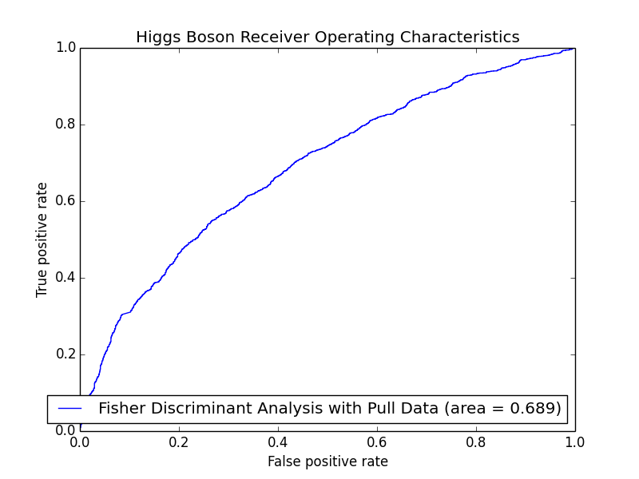
Pull data
Current state of the art classification methods uses jet pull data, which is a superstructure feature of an event which can help determine if jets came from decay of a color-singlet object
The classification method used is Fisher Discriminant Analysis

Slide 5
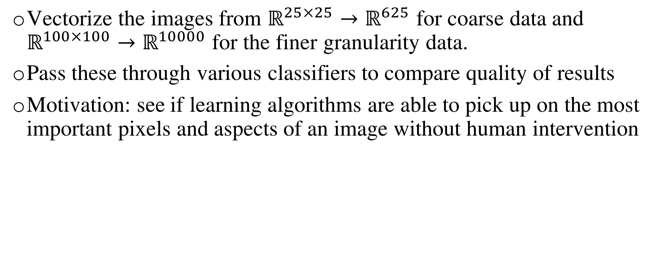
Initial tests
Vectorize the images from $ℝ^{25×25}→ℝ^{625}$ for coarse data and $ℝ^{100×100}→ℝ^{10000}$ for the finer granularity data.
Pass these through various classifiers to compare quality of results
Motivation: see if learning algorithms are able to pick up on the most important pixels and aspects of an image without human intervention

Slide 6
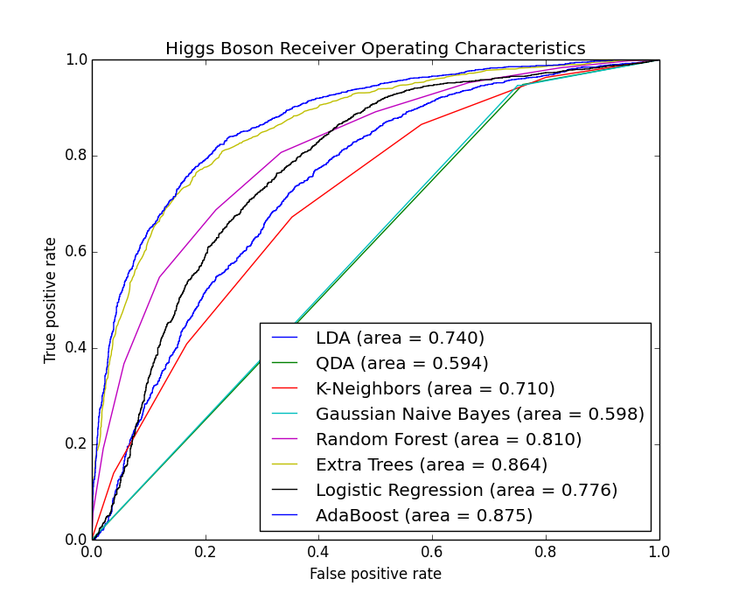
Results on coarse data

Slide 7
Tree classifiers
Decision tree learning uses a decision tree as a predictive model, where leaves represent labels (in this case, higgs and not-higgs) and branches represent conjunctions of features from the data
AdaBoost is a meta-estimator that fits many decision-trees on the dataset, combining them into a weighted sum representing the meta classifier

Slide 8
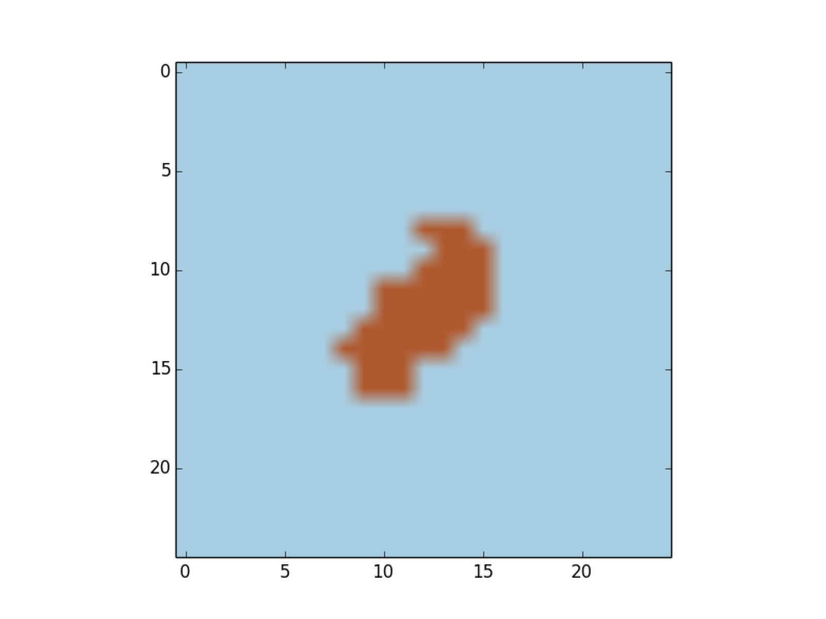
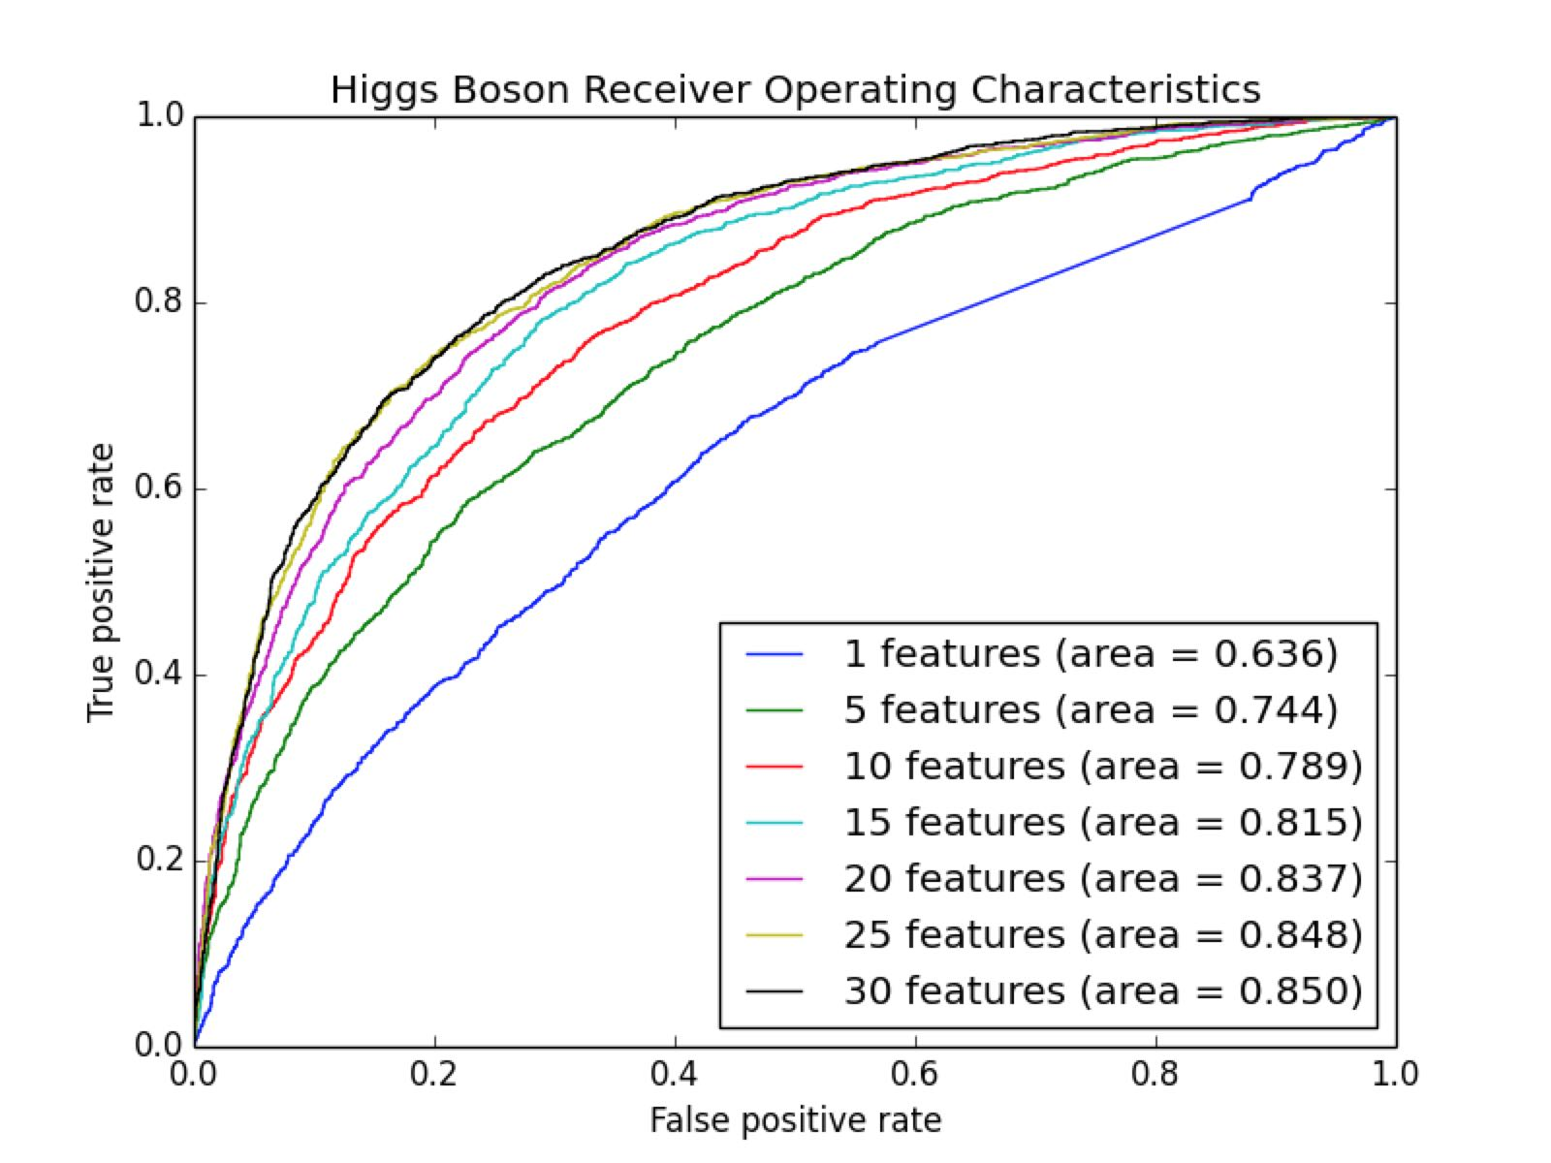
Feature selection

Slide 9
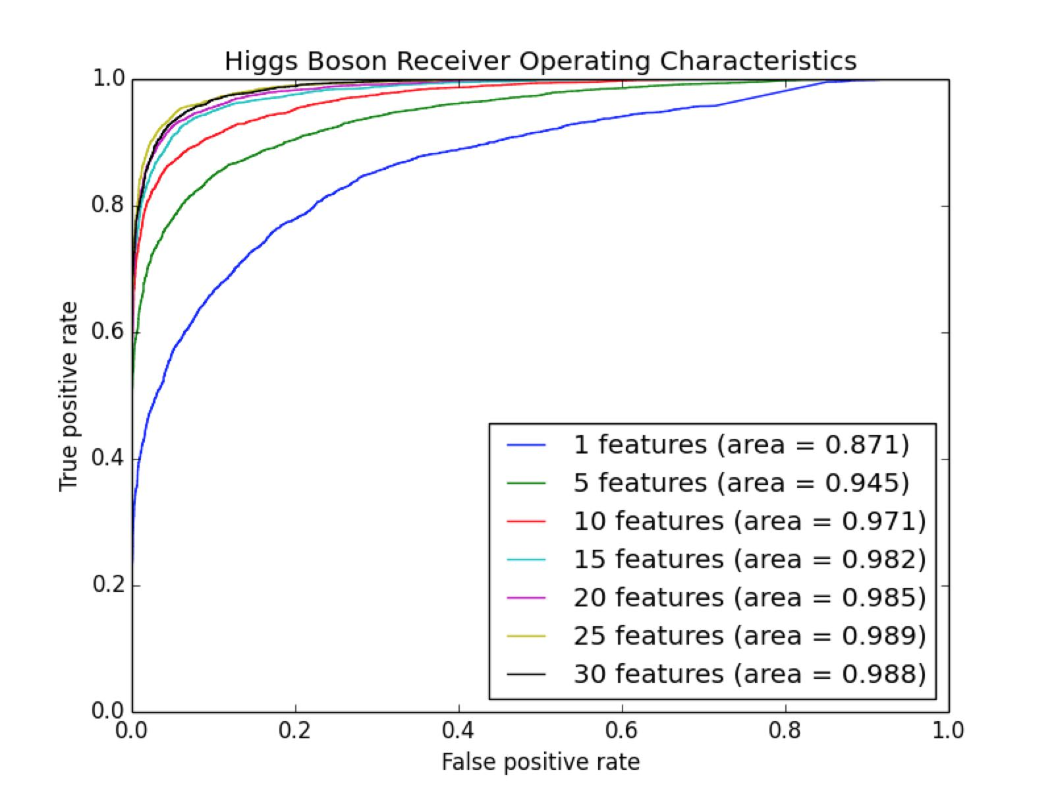
Overfitting on training data

Slide 10
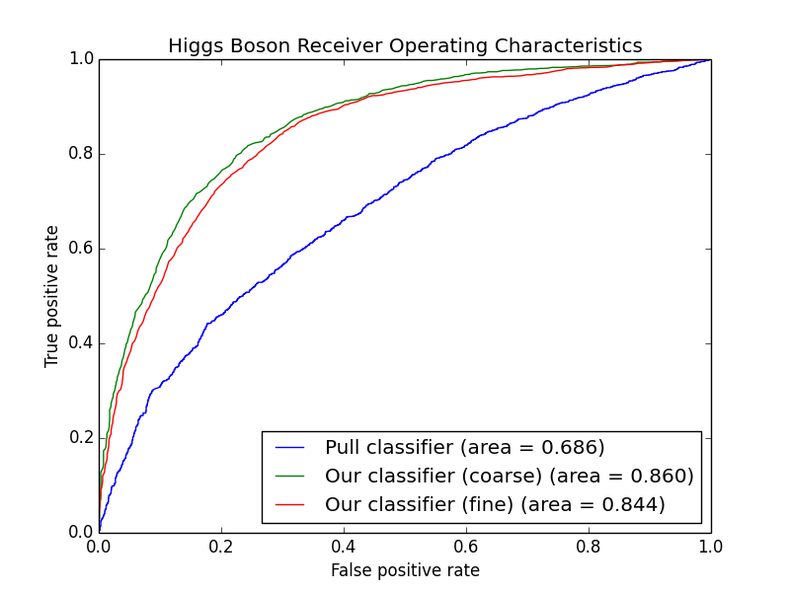
Coarse versus Fine Images

Slide 11
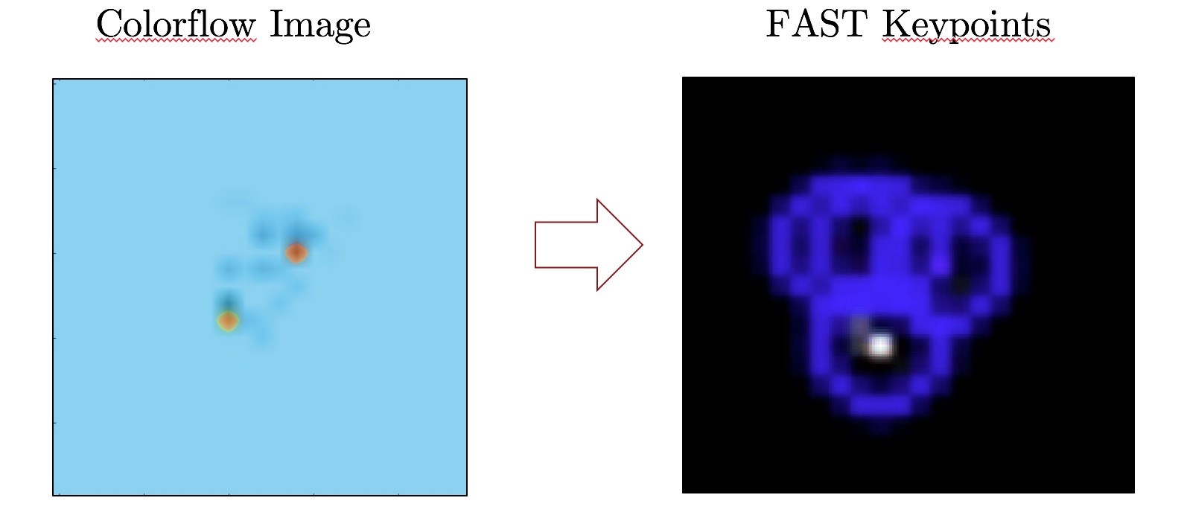
Image recognition
We experimented with various image descriptors, including ORB, BRIEF, and SIFT for the higher granularity images, to see if we could build on top of vectorized pixel features.
The results were unsatisfactory, achieving an AUC of only 0.550.
These descriptors weren’t able to capture many of the nuances of the sparse pixel matrices.
Image histograms of pixel density also proved unsuccessful, resulting in an AUC score of 0.660.

Slide 12
Future work
Test on images with less consistent conditions (no preprocessing, or non-constant resonance)
Use a convolutional neural network as a classification method

Slide 13
References
De Oliveira, Luke, Michael A. Kagan, Lester Mackey, Benjamin Nachman, and Ariel Schwartzman. Deep Convolutional Architectures for Jet-Images at the Large Hadron Collider. N.d. Stanford.
"Deep Learning Tutorials¶." Deep Learning Tutorials — DeepLearning 0.1 Documentation. LISA Lab, n.d. Web. 07 Dec. 2015.
Drucker, Harris. "Improving Regressors Using Boosting Techniques." Proceedings of the 14th International Conference on Machine Learning, Aug. 1997. Web.
Genesereth, Michael, and Michael Thielscher. "Propositional Nets." General Game Playing. Stanford Logic Group, n.d. Web.
Special thanks to Ariel Schwartzman, Ben Nachman and Michael Kagan for their support and guidance during this project

